Slide 1


FAKTOR24 GUIDE
Presentation for Santander Factoring Suppliers in CONFIRMING ® Programs

Slide 2

This guide is meant to present how the operational platform Faktor24 can be used by Suppliers and how to perform basic operations in Supply Chain Finance - Confirming programs.
Faktor24 enables both Buyers and Suppliers not only to exchange data, but also to view and analyze the receivables status and mutual settlements. The platform is accessible through a web browser.
In the further part of this guide you may learn how to confirm receivables.

Slide 3
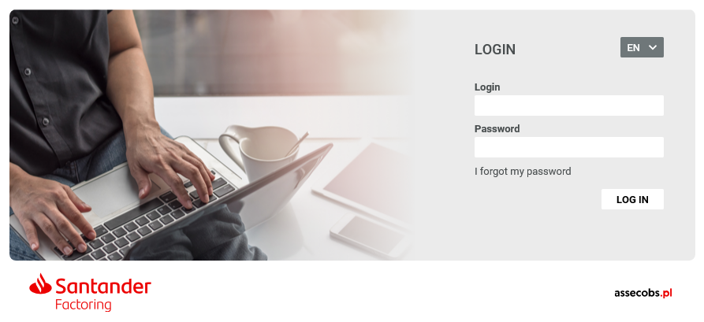

Confirming® - Approving receivables by Supplier
Once invoices are registered in the system and a batch is provided by a Buyer, a Supplier will be notified by an email about new receivables to confirm.
The access details will be provided in two ways: by email (individual user name) and SMS (password).
All operations are done through a web based application available at: https://www.faktor24.pl

Slide 4
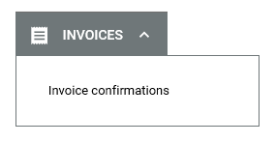
Confirming® - Approving receivables by Supplier
How to confirm invoices submitted by your Buyer?
Once logged into Faktor24, please go to the screen where a Supplier may confirm invoices provided by their Buyer.

Slide 5

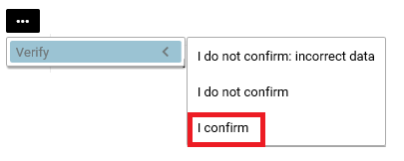
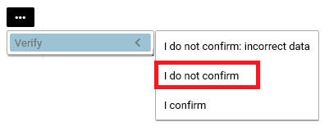
Confirming® - Approving receivables by Supplier
Application enables to:
Confirm invoices by using <I CONFIRM>, which is followed up by an email with a code generated.
A Supplier needs to log into the received code in order to confirm invoices. Such receivables will be financed immediately.
  Decline invoices by selecting out of the list a status: <I DO NOT CONFIRM>
  Such receivables will NEVER be financed by Faktor.

Slide 6
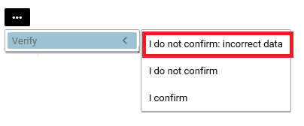
Confirming® - Approving receivables by Supplier
Application enables to:
Flag incorrect data on the invoice by choosing out of the list a status: <I DO NOT CONFIRM: INCORRECT DATA> Choosing this option in an interactive way, both Buyer and Supplier may agree the correct data of the invoice.
Such receivables will be financed immediately upon their confirmation by a Supplier.
  Take no action – by the payment term a Supplier takes no action in respect to the given receivables.
  Such receivables will be financed at the maturity date.

Slide 7
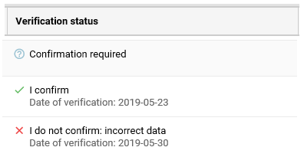
Confirming® - Approving receivables by Supplier
In the screen called <Invoice confirmations> a Supplier may view the status of the verified invoices.

Slide 8


Thank you.

